Slide 1
XDNet: A Few-Shot Meta-Learning Approach for Cross-Domain Visual Inspection
Presented by
Joy Zhuge
Xian Yeow Lee, Lasitha Vidyaratne, Mahbubul Alam, Ahmed Farahat, Dipanjan Ghosh,
Maria Teresa Gonzalez Diaz and Chetan Gupta.
Notes:
Hi, this is joy from hitachi America, we are a R&D lab focused on industrial al, and based in santa clara California. today I am helping my collague to present their work on xdnet, a few shot meta learning approach for cross domain visual inspection

Slide 2
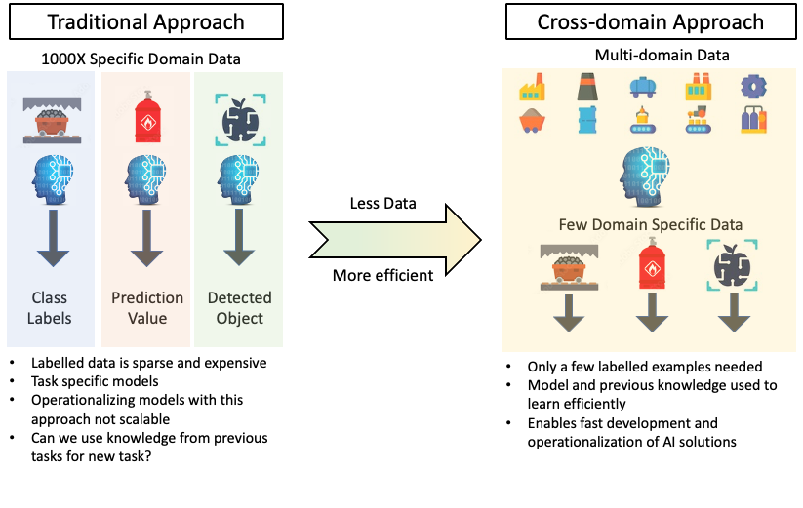
Motivation: Why Cross-Domain Learning?
Notes:
As we all know, data labelling is an expensive work, and nowadays there are lots of well-trained models on large public dataset like coco, pascal, imagenet, designed for specific task. Our goal is to utilize the knowledge from the previous task and apply for the new domain specific task, which only required a few domain specific labelled data, and train the model more efficient.

Slide 3
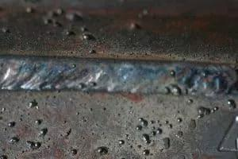
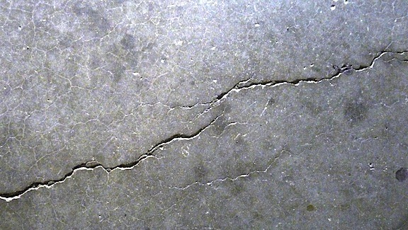
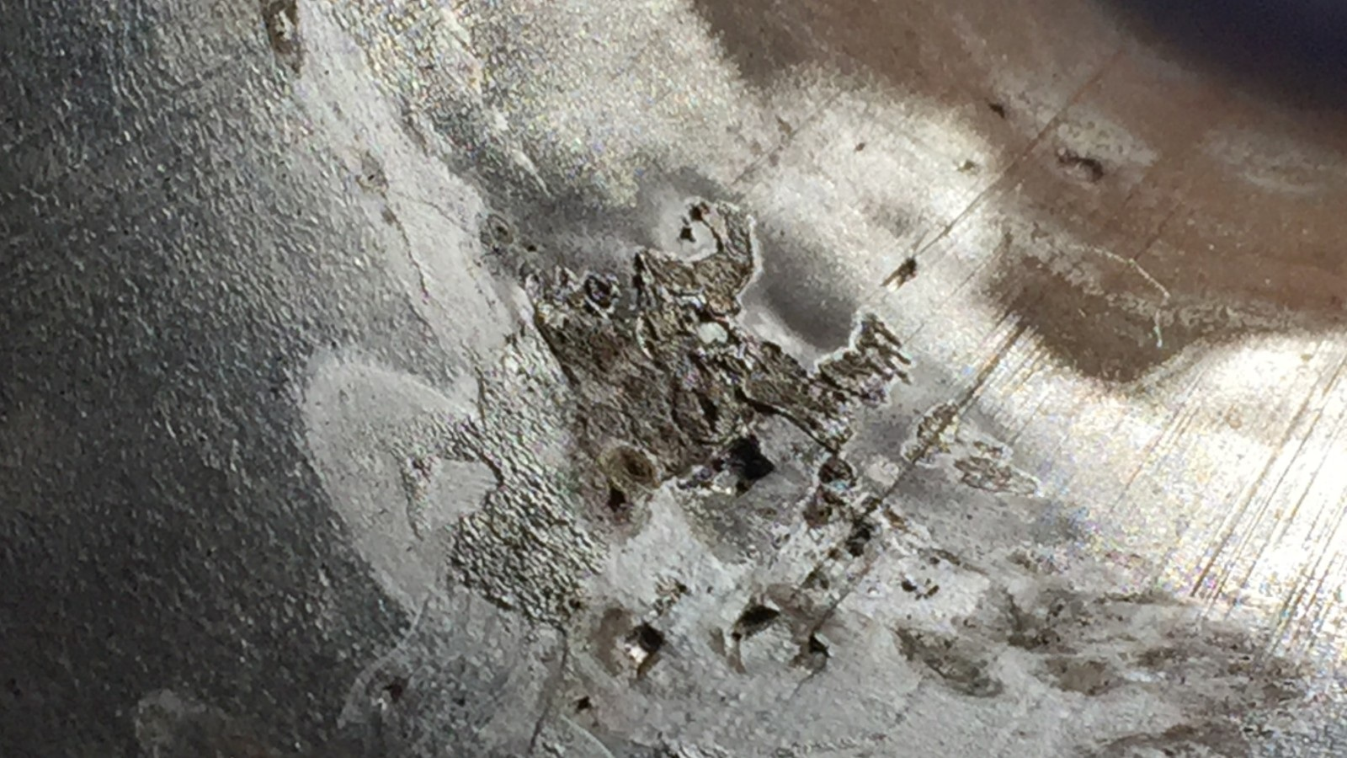
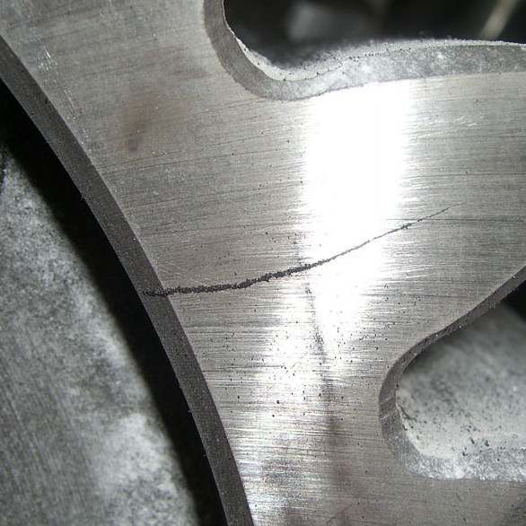
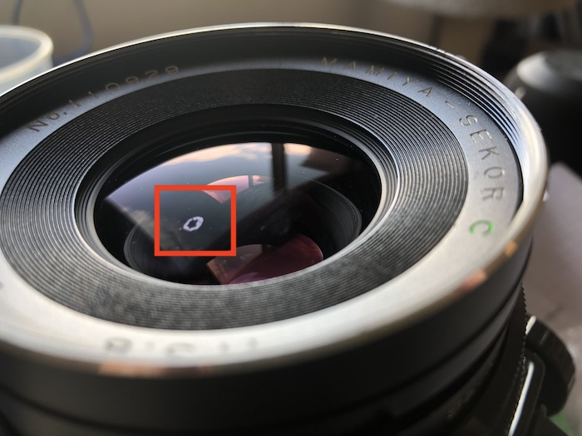
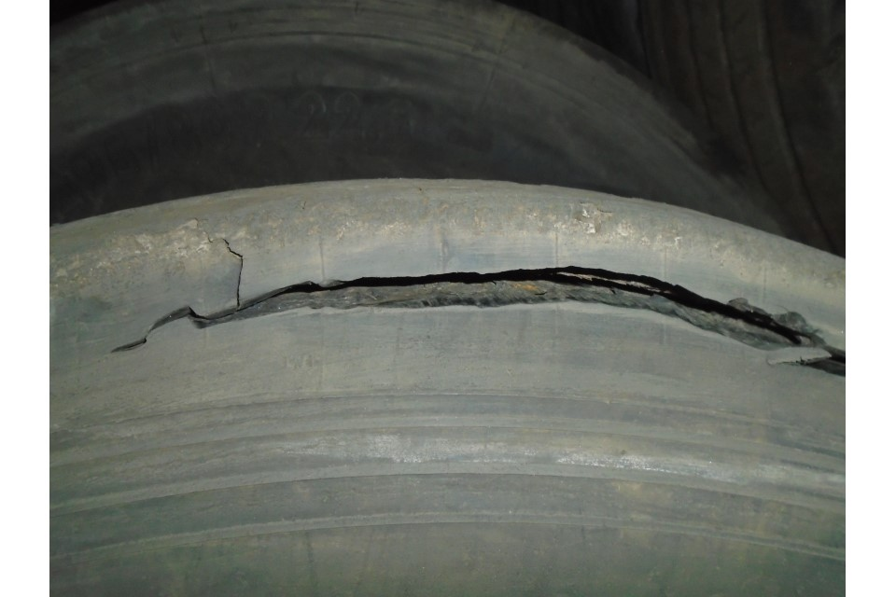
Motivation: Why Visual Inspection?
Automating industrial visual inspection tasks
Improves efficiency and accuracy
Reduces labor and cost
Defect/anomaly detection is an important downstream task of visual inspection
Deep-learning-based methods are widely used for automation
Problems with current state-of-the-art visual inspection models
Requires a large amount of data to train
High computational cost to develop and train new models
Requires a new dataset and a new model for every new application
Examples of visual inspection for defects
Notes:
Our domain here is industrial visual inspection, like we want to automatically detect a crack on a surface, a disconnection on a welding, a scratch on a car, a hole on a camera lens.
We already did some custom projects before, and we want to apply the similar techniques on any new projects.
We want to utilized deep learning based methods to automate the defect or anomaly detection process.
Since the defect is usually very small and very domain specific, the current visual inspection model requires a large amount of data and high computation cost to train a new model.
Moreover, for every new application, it requites a new dataset and a new model.

Slide 4
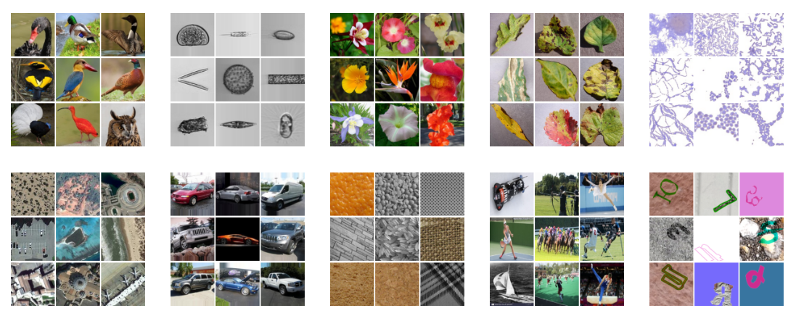
Problem Definition: Cross-Domain Meta-Learning
Research question: Can we develop a model that is generalized across many domains?
Meta-learning: ‘Learning to learn’ / learn how to combine predictions from other learners / multi-task learning
Learn from a variety of tasks and generalize to new tasks with few examples (few shot)
Birds
Plankton
Flowers
Plant Diseases
Microscopy (Bacteria)
Remote Sensing
Vehicles
Manufacturing
Human Action
OCR
Images from the NeurIPS 2022 Cross-Domain Meta Learning Competition Dataset¹
Notes:
To address the problem that can we develop a model which can be generalized across many domain.
We leverage on cross domain few shot meta-learning, we want to learn a variety of tasks and generalize to a new task with only few example.
For instance, we have a well developed classification model trained on thousand of flowers images, it is not applicable to directly inference on bird classification with only 5 or 10 birds images, we hope cross domain meta learning can solve these few shot problem.

Slide 5
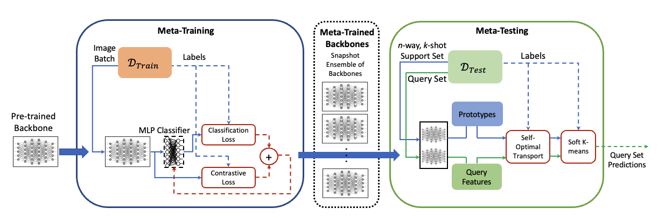
Proposed Architecture: XDNet
Meta-Training
Backbone selection
SEResnext101aa: Squeeze and excitation modules, Anti aliasing filters
Loss function
Supervised loss, Contrastive loss (triple margin loss)
More generalizable feature extraction
Meta-Testing
Self-Optimal Transport (SOT) feature transform
Maps the features based on similarity
Soft k-means based transductive decoder
Process to cluster the support features and assign query features to closest clusters iteratively
Observed gradient based methods(logistic regression) ensemble methods (random forest, gradient boosting) are suboptimal
Notes:
Here is the architecture we used for the Xdnet.
In the meta-trainining phase, we selected the SEResnext101aa as backbone, the squeeze and excitation modules ensure the channel wise attention, the anti aliasing low pass filter can help the generalization, we freeze all the other layer, only train the last two layers of the backbone. During the training, we took snapshot ensemble of the bones, we selected the best three snapshot on validation.
In the meta-testing phase, the support and query set go through the ensemble of backbones to get feature and concatenate them to a 1D scalar; in n-way k-shot setting, one prototype represents one class, by averaging k examples, there will be n protypes. Then they used SOT feature transform trick to map the feature based on similarity. And then the prototypes and query feature will go through a soft k mean classfier iteratively to get the query set prediction.

Slide 6
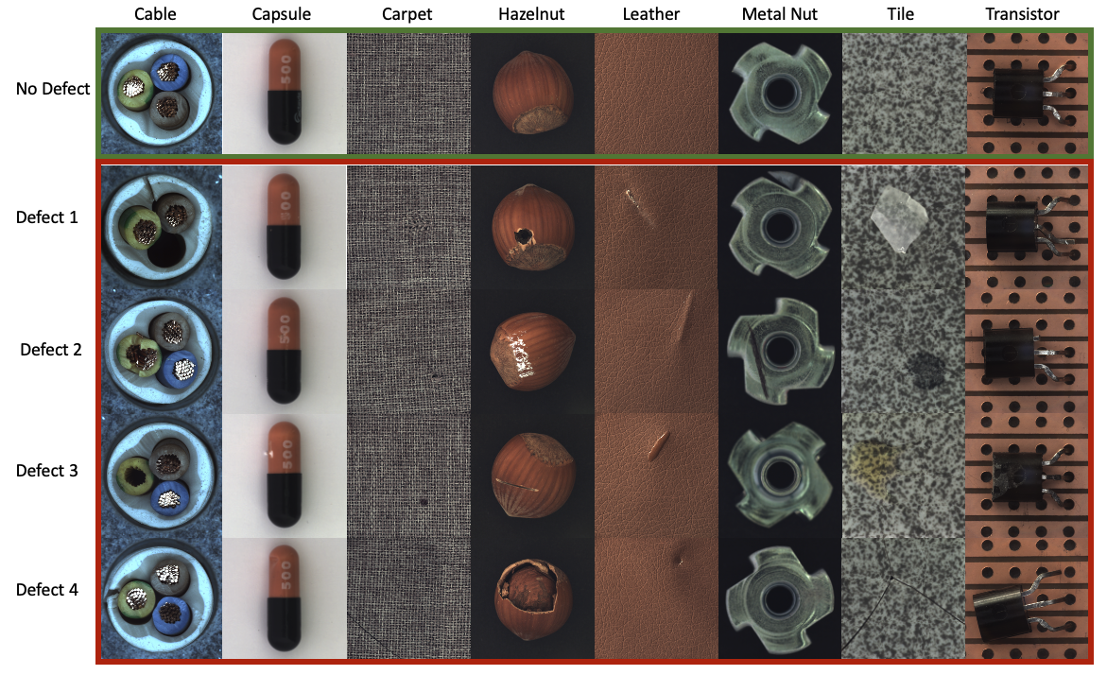
Defect Detection Dataset
MVTec benchmark dataset for defect detection
Traditional performance criteria does not provide the true measure the model performance
Model performance must be computed on n-way k-shot tasks
‘Normalized average accuracy’ as evaluation criteria;
Where ${Acc}_{class}$ is the averaged accuracy per class in a specific task, and ${Acc}_{rc}$ represents the accuracy of a random classifier
As such, ${Acc}_{normalized}>0$ represents a performance better than a random classifier
Meta-Train
Meta-Test
$${Acc}_{normalized}=\frac{{Acc}_{class}−{Acc}_{rc}}{1−{Acc}_{rc}}$$
Example of a visual inspection benchmark dataset from MVTec²
Notes:
We utilized MVTec as benchmark dataset to evaluate our result. For example, it has classes like cable, carpet, leather, 14 classes in total. For each class, they has different defect type, ensure our n-way, k-shot setting.
And since we want to measure the model performance on n-way k-shot tasks, we utilized normalized average accuracy as evaluation criteria. ACC_RC represent a random classifier, ACC_class is the average accuracy per class.
Normalized average accuracy range from 0 to 1, larger number means better performance.

Slide 7
Baseline Models for Comparison
Training from Scratch
A single backbone feature extractor (initialized with weights trained on ImageNet)
Train the model directly on tasks sampled at meta-testing (no meta-training)
Add a task specific MLP and train both MLP and backbone on the task
Transfer Learning
Architecturally similar to training from scratch
Model undergoes meta-training with the training datasets
Tests if meta-training on industrial images from multiple domains is beneficial
Prototypical Networks (ProtoNets)³
A metric-learning based meta-learning algorithm
ProtoNet is trained in an episodic manner in meta-training phase
In Meta-testing, obtains class of query set using a distance-based measure between query and support set prototypes
Notes:
Other than the Xdnet, we also compare our performance with other baseline model.
We use a single backbone feature extractor which intialized the weight with imagenet, adding a task specific mlp, and train them directly on tasks sampled at meta-testing.
We also compare transfer learning, same architexture as from scratch, the model is trained on meta training.
Protonet, which trained in an episodic manner in meta-training phase, which one class after another, and in meta-testing phase, instead of k-means, it obtain the class prediction with a distance-based measure between the query and support set prototype.

Slide 8
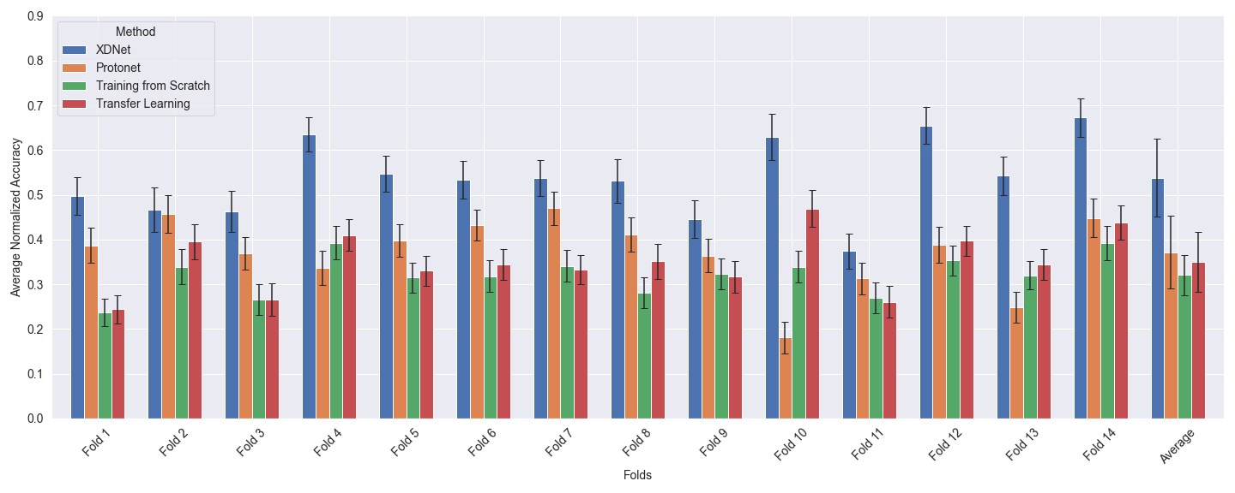
Results: Performance comparison
Notes:
The mvtec dataset has14 classes, out of the 14, only 8 has at least 5 way 10 shot(upper bound), so we designed a 14 fold cross validation to ensure at least 2 dataset overlapped between each fold.
The blue bar is the xdnet, either in single fold or the average performance, we can conclude the xdnet performance better than the other three, with at least one standard deviation.

Slide 9
Results: Dataset Specific Performance
XDNet shows higher performance on most data domains
Model seem to perform well on textured domains: ‘leather’, ‘tile’ and ‘carpet’
Moderately well on ‘cable’, ‘hazelnut’, ‘metal nut’, and ‘transistor’ domains
Performs poorly on ‘capsule’
Performance is consistent across folds
Low standard deviation
Notes:
We also average the normalized accuracy based on different class. We observed that only for capsule, protonet perform better.
We have an observation that Model seem to perform well on textured domains: ‘leather’, ‘tile’ and ‘carpet’
Moderately well on ‘cable’, ‘carpet’, ‘hazelnut’, ‘metal nut’, and ‘transistor’ domains
Performs poorly on ‘capsule’.
But the performance is consistent across fold with low std.

Slide 10
Ablation Study on XDNet Framework
Squeeze-excitation architecture and anti-aliasing filters
This ablation forces the backbone feature extractors to default to the basic ResNet101 architecture
Self-Optimal Transport (SOT) feature transform
This ablation removes SOT during meta-testing phase
Forwards the raw embeddings directly to soft k-means based transductive decoder
Ensemble of feature extractors
This ablation removes the snapshot ensembling technique during meta-training phase
A single backbone is used during meta-testing to extract feature embeddings
Contrastive Loss
This ablation removes the contrastive loss term during the meta-training phase
Model is only trained using classification loss
Notes:
Furthermore, to find the best design of the model, and find the influence of the each individual component, we conducted several ablation study.
Instead of SEResnext101aa, we use normal ResNet101
We remove the sot feature transform
We remove the snapshot ensemble
We remove the contrastive loss

Slide 11
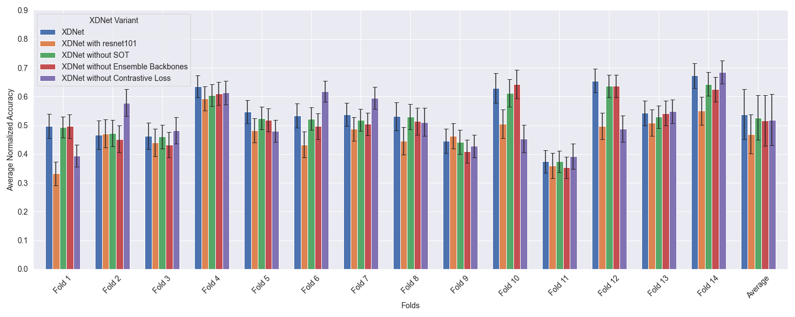
Results: Ablation Study
Notes:
From the result,
The backbone architecture has the biggest impact on performance. SOT has the smallest impact.

Slide 12
Conclusion
Meta-learning is promising for industrial applications
Generalizable to multiple applications
Requires less labelled examples
Potential to accelerate the deployment of AI models in the field
A framework for cross-domain industrial visual inspection: XDNet
Performance comparison with other models on a benchmark industrial visual inspection database MVTec
Efficient adaptation to new domains with higher performance
Ablation study shows that changes to the model's architecture had the most significant effect on performance.
Specific domains of data remain challenging to learn, despite the framework performing better than other baselines.
Next step: classification -> segmentation
Notes:
In conclusion, we found out meta learning is promising for industrial applications.
We designed a cross domain meta learning architecture called XDnet which is promising on few shot classification problem, we evaluated the performance based on mvtec, a benchmark industrial visual inspection database, which has pretty good performance. Ablation study shows that changes to the backbone architecture had the most significant effect on performance
Next step, instead of classification, we want to investigate the segmentation problem.

Slide 13
References
Carrión-Ojeda, Dustin, et al. "NeurIPS’22 Cross-Domain MetaDL competition: Design and baseline results." ECMLPKDD Workshop on Meta-Knowledge Transfer. PMLR, 2022.
Snell, Jake, Kevin Swersky, and Richard Zemel. "Prototypical networks for few-shot learning." Advances in neural information processing systems 30 (2017).
Bergmann, Paul, et al. "MVTec AD--A comprehensive real-world dataset for unsupervised anomaly detection." Proceedings of the IEEE/CVF conference on computer vision and pattern recognition. 2019.

